Slide 1
Unit IV Graph concepts
Scs1201 – advanced data structures
Semester iii / year ii

Slide 2
Syllabus
Minimum Spanning Tree
Kruskal’s Algorithm
Prim’s Algorithm
Sollin’s Algorithm
Shortest Path Algorithms
Dijkstra’s Algorithm
Bellman Ford
Floyd Warshall Algorithm

Slide 3
Minimum Spanning Tree
A tree T is a spanning tree of G if T is a spanning sub-graph of G.
Every spanning tree of a connected n-node graph G has (n-1) arcs.
Acyclic Tree.
The arcs belonging to a spanning tree are called tree arcs and the rest are called non-tree arcs.

Slide 4
Example – Undirected Graph
v₁
v₂
v₁
v₂
v₁
v₂
v₃
v₄
v₃
v₄
v₃
v₄
v₁
v₂
v₁
v₂
v₁
v₂
v₃
v₄
v₃
v₄
v₃
v₄

Slide 5
Example – Directed Graph
2
4
2
4
1
5
7
1
5
7
3
6
3
6

Slide 6
Applications
Designing Physical Systems (E.g. Pipeline)
Optimal Message Passing
Reducing Data Storage
Cluster Analysis
All Pairs minimax Path Problem

Slide 7
Minimum Cost Spanning Trees
The cost of a spanning tree of a weighted undirected graph is the sum of the costs of the edges in the spanning tree
A minimum cost spanning tree is a spanning tree of least cost
Select n-1 edges from a weighted graph of ‘n’ vertices with minimum cost

Slide 8
Algorithms
Kruskal’s Algorithm
Prim’s Algorithm
Sollin’s Algorithm

Slide 9
Greedy Strategy
An optimal solution is constructed in stages
At each stage, the best decision is made at this time
Since this decision cannot be changed later, it is ensured that the decision will result in a feasible solution
Typically, the selection of an item at each stage is based on a least cost or a highest profit criterion

Slide 10
Kruskal’s Approach
Build a minimum cost spanning tree T by adding edges to T one at a time
Select the edges for inclusion in T in the non-decreasing order of the cost
An edge is added to T if it does not form a cycle
Since G is connected and has n > 0 vertices, exactly n-1 edges will be selected

Slide 11
Example
0 5
2 3
1 6
1 2
3 6
3 4
4 6
4 5
0 1
10
12
14
0
0
28
10
1
1
16
14
16
6
2
18
5
5
6
2
24
25
18
22
4
12
4
22
3
3
24
25
28

Slide 12

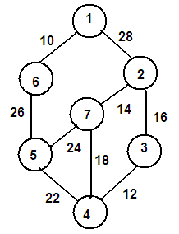

Kruskals Algorithm

Slide 14
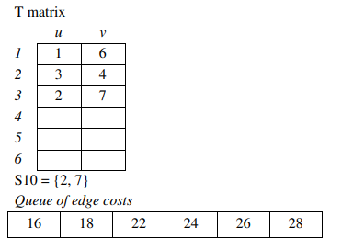
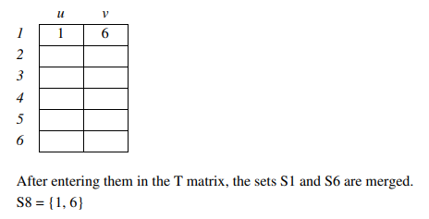
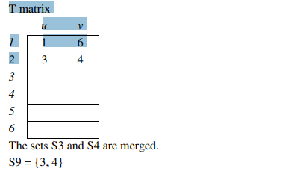
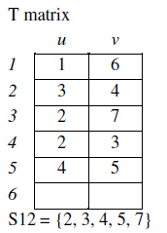

Slide 15
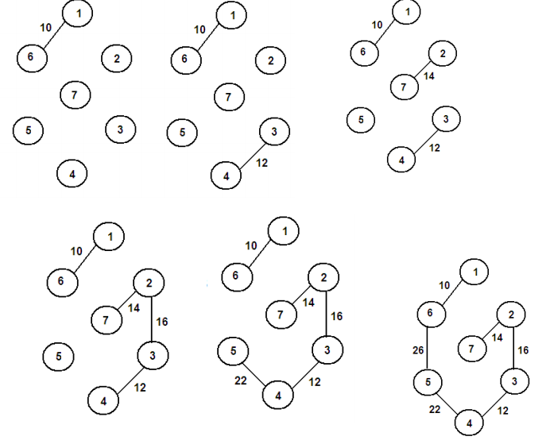

Slide 16
Contd…
0 5
2 3
1 6
1 2
3 6
3 4
4 6
4 5
0 1
10
12
0
0
14
0
3 6
+
10
1
1
cycle
10
10
1
16
14
5
6
2
5
6
2
18
5
6
2
4
12
12
22
4
4
3
3
3
24
25
28

Slide 17
Contd…
0 5
2 3
1 6
1 2
3 6
3 4
4 6
4 5
0 1
10
12
0
0
+
4 6
14
1
10
1
10
cycle
14
16
14
16
16
5
6
2
5
6
2
18
25
12
12
4
4
22
22
22
3
3
24
cost = 10 + 25 + 22 + 12 + 16 + 14
= 99
25
28

Slide 18
MST_Kruskal(G, W)
A ← Ø
for each vertex v ϵ V[G]
do MAKE_SET(v)
Sort the edges of E into non-decreasing order by weight w
do if find_set(u) ≠ find_set(v) then
A ← A u { (u, v) }
UNION(u, v)
Return A

Slide 19
Pseudocode
KRUSKAL(E, cost, n, t)
Construct a queue with edge costs such that they are in ascending order
i = 0, mincost = 0
while i < n – 1 and queue is not empty
Delete minimum cost edge (u, v) from queue
j = Find(u),
k = Find(v)
If j ≠ k
i = i + 1
t[i, 1] = u
t[i, 2] = v
minimum_cost = minimum_cost + cost[u, v]
mincost = mincost + cost[u, v]
Union(j, k)
End if
End while
If i ≠ n – 1
Print “Not a spanning tree”
Else
Return minimum_cost
End if
End KRUSKAL

Slide 20
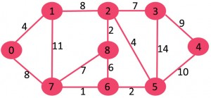
Example 2

Slide 21
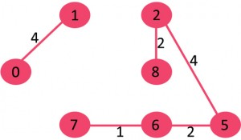
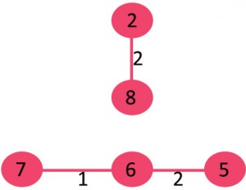
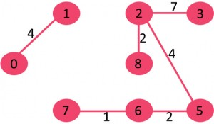

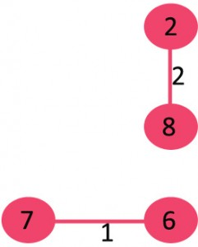
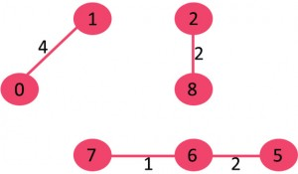
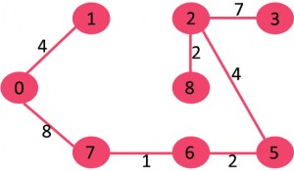
Solution

Slide 22
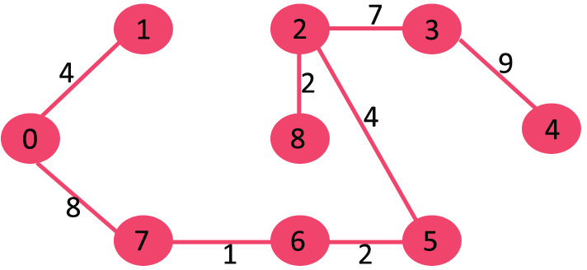
Minimum Cost Spanning Tree
cost = 4+ 8 + 1 + 2 + 2 + 4 + 7 + 9
= 37

Slide 23
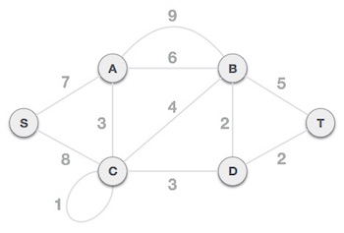
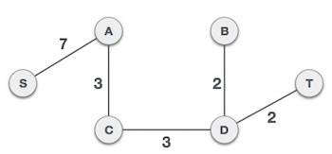
Example 3

Slide 24
Example 4
8
10
14
10
14
1
3
5
7
1
3
5
7
7
12
6
3
7
6
3
2
4
2
4
2
4
6
8
2
4
6
8
9

Slide 25
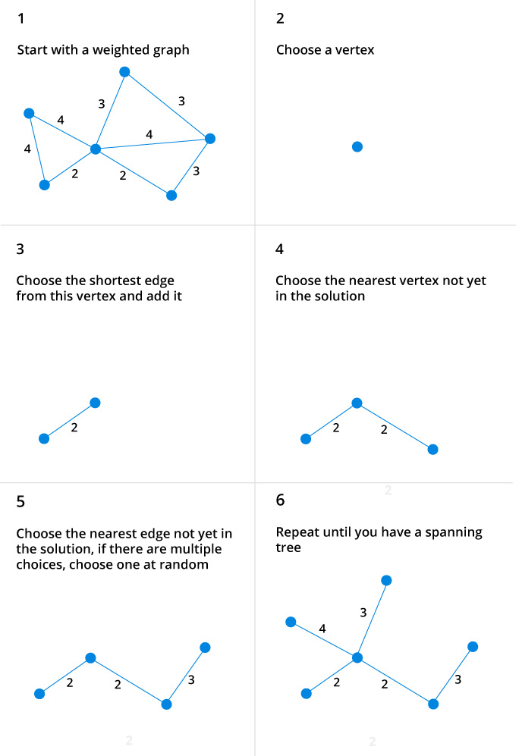
Example 5

Slide 26
Prims algorithm

Slide 27
Prim’s Algorithm
Popular algorithm for constructing the minimum spanning tree
Follows greedy approach
Prim's algorithm, in contrast with Kruskal's algorithm, treats the nodes as a single tree and keeps on adding new nodes to the spanning tree from the given graph.
The Prim’s algorithm was developed by Vojtěch Jarník and it was later discovered by the duo Prim and Dijkstra.
Therefore, Prim’s algorithm is also known as DJP Algorithm.

Slide 28
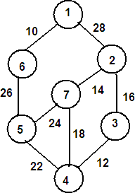
1 2 3 4 5 6 7
12
3
4
5
6
7
0 | 28 | ∞ | ∞ | ∞ | 10 | ∞
28 | 0 | 16 | ∞ | ∞ | ∞ | 14
∞ | 16 | 0 | 12 | ∞ | ∞ | ∞
∞ | ∞ | 12 | 0 | 22 | ∞ | 18
∞ | ∞ | ∞ | 22 | 0 | 26 | 24
10 | 26 | ∞ | ∞ | ∞ | 0 | ∞
∞ | 14 | ∞ | 18 | 24 | ∞ | 0
Step 1:
Select the least cost edge from the graph and enter into the T matrix. The least cost edge is (1, 6) with cost 10. T matrix
0
28
∞
∞
26
0
∞
12
3
4
5
6
7
1
1
1
1
6
6
1
Calculate near array
If cost[i, l] < cost[i, k]
Near[i] = l
Else
Near[i] = k
 | u | v
1 | 1 | 6
2
3
4
5
6

Slide 29
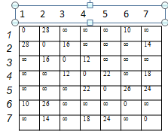
Make the entries in the NEAR array corresponding to 1 and 6 as 0. For all non-zero entries in the near array, find out the cost[j][near[j]]. Select the minimum among these costs and enter the corresponding nodes into the T matrix.
28
∞
∞
26
∞
 | u | v
1 | 1 | 6
2 | 5 | 6
3
4
5
6
12
3
4
5
6
7
0
1
1
1
6
0
1
Among the costs, 26 is minimum. Hence (5, 6) is entered into the T matrix. The corresponding entry into the NEAR array is made 0.
T matrix

Slide 30
If Near[k] ≠ 0 and cost[k, Near[k]] > cost[k, j]
Near[k] = j
 | u | v
1 | 1 | 6
2 | 5 | 6
3 | 4 | 5
4
5
6
1
2
3
4
J=5
6
7
0
1
1
5
0
0
5
28
∞
22
24
Updated T matrix
Among the cost computed, 22 is minimum and hence (4,5) is selected as the minimum edge.

Slide 31
1
2
3
J=4
5
6
7
0
1
4
0
0
0
5
28
12
18
 | u | v
1 | 1 | 6
2 | 5 | 6
3 | 4 | 5
4 | 3 | 4
5
6

Slide 32
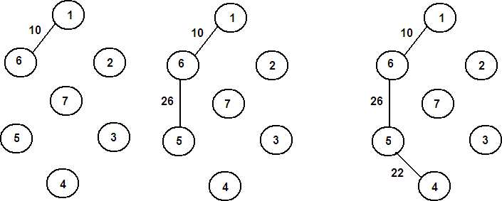
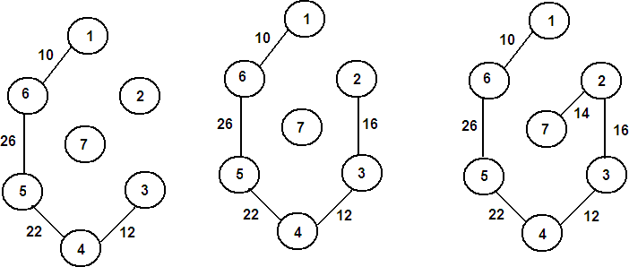

Slide 33
Prims Algorithm
PRIM(E, cost, n, t)
Let (k, L) be an edge of minimum cost in E mincost = cost[k, L]
t[1, 1] = k, t[1, 2] =L
For i = 1 to n
If cost[i, L] < cost[i, k]
Near[i] = L
Else
Near[i] = k
End if End for
Near[k] = Near[L] = 0 For i = 2 to n -1
Let j be an index such that near[j] ≠ 0 and cost[j, near[j]] is minimum
T[i, 1] = j, t[i, 2] = Near[j]
mincost = mincost + cost[j, near[j]] Near[j] = 0
For k = 1 to n
If Near[k] ≠ 0 and cost[k, Near[k]] > cost[k, j] Near[k] = j
End if End for
Return mincost End PRIM

Slide 34
Step 1 - Remove all loops and parallel edges
Remove all loops and parallel edges from the given graph. In case of parallel edges, keep the one which has the least cost associated and remove all others.

Slide 35
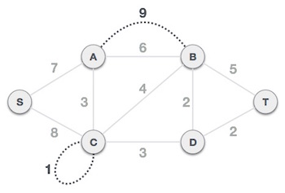
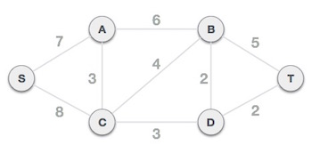
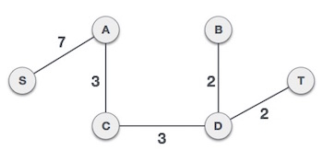

Slide 36
SOLLIN’S ALGORITHM
Sollin’s Algorithm
{
Form a forest consisting of the nodes of the graph while the forest has more than one tree For each tree in the forest
Choose the cheapest edge
Form a vertex in the tree to a vertex not in the tree Merge trees with common vertices
}

Slide 37
Sollin’s Algorithm based on two basic operations
Nearest Neighbor – This operation takes a an input a tree spanning the nodes N_{k} and determines an arc (i_{k} , j_{k}) with the minimum cost among all arcs emanating from N_{k}.
Merge (i_{k} j_{k}) – This operation takes as an input two nodes i_{k} and j_{k},and if the two nodes belong to two different trees, then merge these two trees into a single tree

Slide 38
Sollins Algorithm (or Boruvka)
1) Input is a connected, weighted and directed graph.
2) Initialize all vertices as individual components (or sets).
3) Initialize MST as empty.
4) While there are more than one components, do following for each component.
a) Find the closest weight edge that connects this component to any other component.
b) Add this closest edge to MST if not already added.
5) Return MST.

Slide 39
Example
Component Low Cost Edge
{0} 0-1
{1} 0-1
{2} 2-8
{3} 2-3
{4} 3-4
{5} 5-6
{6} 6-7
{7} 6-7
{8} 2-8

Slide 40
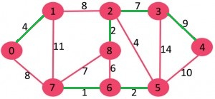
Low Cost Edges (Level 1)
{0-1, 2-8, 2-3, 3-4, 5-6, 6-7}

Slide 41
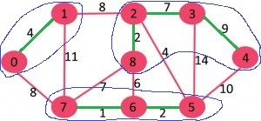
Level 2
{{0,1}, {2,3,4,8}, {5,6,7}}
Component Low Cost Edge
{0,1} 1-2 (or 0-7)
{2,3,4,8} 2-5
{5,6,7} 2-5

Slide 42
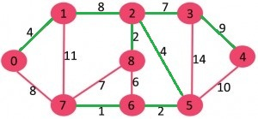
Level 3
{0-1, 2-8, 2-3, 3-4, 5-6, 6-7, 1-2, 2-5}

Slide 43
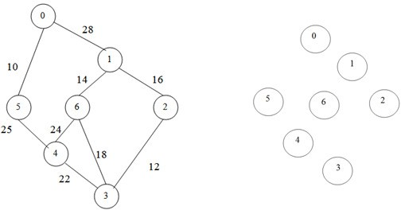
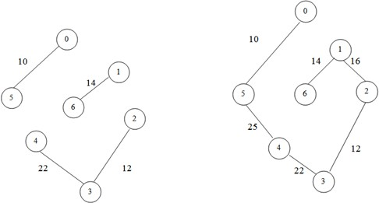

Slide 44
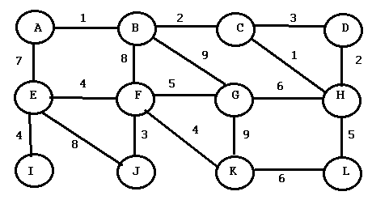
Problem – Minimum Cost Spanning Tree

Slide 45
SHORTEST PATH ALGORITHMS

Slide 46
Algorithms
Single Source Shortest Path
Dijkstras Algorithm
Bellman Ford Algorithm
All Pairs Shortest Path
Floyd Warshall

Slide 47
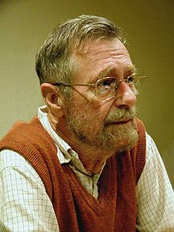
Edsger Wybe Dijkstra
- May 11, 1930 – August 6, 2002
- Received the 1972 A. M. Turing Award, widely considered the most prestigious award in computer science.
- The Schlumberger Centennial Chair of Computer Sciences at The University of Texas at Austin from 1984 until 2000
- Made a strong case against use of the GOTO statement in programming languages and helped lead to its deprecation.
- Known for his many essays on programming.

Slide 48
Dijkstra’s Algorithm
Solution to the single-source shortest path problem in graph theory.
Works on both directed and undirected graphs.
All edges must have nonnegative weights.
Approach: Greedy
Input: Weighted graph G={E,V} and source vertex v∈V, such that all edge weights are nonnegative
Output: Lengths of shortest paths from a given source vertex v∈V to all other vertices

Slide 49
Pseudocode
dist[s] ←0 (distance to source vertex is zero)
for all v ∈ V–{s}
do dist[v] ← ∞ (set all other distances to infinity)
S←∅ (S, the set of visited vertices is initially empty)
Q←V (Q, the queue initially contains all vertices)
while Q ≠ ∅ (while the queue is not empty)
do u ← mindistance(Q,dist) (select the element of Q with the min. dist)
S←S ∪ {u} (add u to list of visited vertices)
for all v ∈ neighbors[u]
do if dist[v] > dist[u] + w(u, v) (if new shortest path found)
then dist[v] ←dist[u] + w(u, v) (set new value of shortest path)
return dist

Slide 50
Example
∞
∞
Initialize
2
B
D
10
A | B | C | D | E
0 | ∞ | ∞ | ∞ | ∞
A
0
1
4
8
7
9
3
C
2
E
S={}
∞
∞

Slide 51
Visit A
10
∞
A | B | C | D | E
0 | ∞ | ∞ | ∞ | ∞
 | 10 | 3
B
2
D
10
0
A
1
4
8
7
9
3
S={A}
C
2
E
3
∞

Slide 52
Visit C
10
∞
A | B | C | D | E
0 | ∞ | ∞ | ∞ | ∞
 | 10 | 3
B
2
D
10
0
A
1
4
8
7
9
3
C
2
E
S={A, C}
3
∞

Slide 53
Start from C
A | B | C | D | E
0 | ∞ | ∞ | ∞ | ∞
 | 10 | 3
 | 7 |  | 11 | 5
7
11
B
2
D
10
0
A
1
4
8
7
9
3
C
2
E
S={A, C}
3
5

Slide 54
Visit E
A | B | C | D | E
0 | ∞ | ∞ | ∞ | ∞
 | 10 | 3
 | 7 |  | 11 | 5
7
11
B
2
D
10
0
A
1
4
8
7
9
3
C
2
E
S={A, C, E}
3
5

Slide 55
Start from E
A | B | C | D | E
0 | ∞ | ∞ | ∞ | ∞
 | 10 | 3
 | 7 |  | 11 | 5
 |  |  | 14
7
11
B
2
D
10
0
A
1
4
8
7
9
3
C
2
E
S={A, C, E}
3
5

Slide 56
Backtrack to C
A | B | C | D | E
0 | ∞ | ∞ | ∞ | ∞
 | 10 | 3
 | 7 |  | 11 | 5
 | 7 |  | 11
7
11
B
2
D
10
0
A
1
4
8
7
9
3
C
2
E
S={A, C, E}
3
5

Slide 57
Visit B
A | B | C | D | E
0 | ∞ | ∞ | ∞ | ∞
 | 10 | 3
 | 7 |  | 11 | 5
 | 7 |  | 11
7
11
B
2
D
10
0
A
1
4
8
7
9
3
C
2
E
S={A, C, E, B}
3
5

Slide 58
Start from B
A | B | C | D | E
0 | ∞ | ∞ | ∞ | ∞
 | 10 | 3
 | 7 |  | 11 | 5
 | 7 |  | 11
7
11
B
2
D
10
0
A
1
4
8
7
9
3
C
2
E
S={A, C, E, B}
3
5

Slide 59
Visit D
A | B | C | D | E
0 | ∞ | ∞ | ∞ | ∞
 | 10 | 3
 | 7 |  | 11 | 5
 | 7 |  | 9
7
9
B
2
D
10
0
A
1
4
8
7
9
3
C
2
E
S={A, C, E, B, D}
3
5

Slide 60
Problem – Source Vertex: B
B
2
D
10
A
1
4
8
7
9
3
C
2
E

Slide 61
Algorithm
DJIKSTRA(v, cost, dist, n)
For i = 1 to n
S[i] = false Dist[i] = ∞
End for S[v] = true
Dist[v] = 0
Create n lists each beginning with v For num = 1 to n – 1
Choose u from among those vertices not in S such that dis[u] is minimum S[u] = true
For each w adjacent to u with s[w] = false If Dist[w] > Dist[u] + cost[u, w]
Dist[w] = Dist[u] + cost [u, w] List[w] = List[u] + w
End if End for
End for

Slide 62
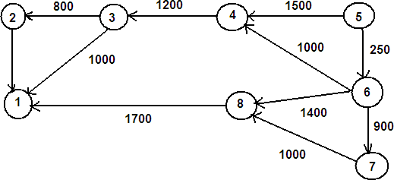
Iteration | S | Vertex Selected | Dist[ ]
 |  |  | 1 | 2 | 3 | 4 | 5 | 6 | 7 | 8
Initial | - | - | ∞ | ∞ | ∞ | 1500 | 0 | 250 | ∞ | ∞

Slide 63
Iteration | S | Vertex Selected | Dist[ ]
 |  |  | 1 | 2 | 3 | 4 | 5 | 6 | 7 | 8
Initial | - | - | ∞ | ∞ | ∞ | 1500 | 0 | 250 | ∞ | ∞
 | 5 | 6 | ∞ | ∞ | ∞ | 1250 | 0 | 250 | 1150 | 1650

Slide 64
Iteration | S | Vertex Selected | Dist[ ]
 |  |  | 1 | 2 | 3 | 4 | 5 | 6 | 7 | 8
Initial | - | - | ∞ | ∞ | ∞ | 1500 | 0 | 250 | ∞ | ∞
 | 5 | 6 | ∞ | ∞ | ∞ | 1250 | 0 | 250 | 1150 | 1650
 | 5,6 | 7 | ∞ | ∞ | ∞ | 1250 | 0 | 250 | 1150 | 1650

Slide 65
Iteration | S | Vertex Selected | Dist[ ]
 |  |  | 1 | 2 | 3 | 4 | 5 | 6 | 7 | 8
Initial | - | - | ∞ | ∞ | ∞ | 1500 | 0 | 250 | ∞ | ∞
 | 5 | 6 | ∞ | ∞ | ∞ | 1250 | 0 | 250 | 1150 | 1650
 | 5,6 | 7 | ∞ | ∞ | ∞ | 1250 | 0 | 250 | 1150 | 1650
 | 5,6,7 | 4 | ∞ | ∞ | 2450 | 1250 | 0 | 250 | 1150 | 1650

Slide 66
Iteration | S | Vertex Selected | Dist[ ]
 |  |  | 1 | 2 | 3 | 4 | 5 | 6 | 7 | 8
Initial | - | - | ∞ | ∞ | ∞ | 1500 | 0 | 250 | ∞ | ∞
 | 5 | 6 | ∞ | ∞ | ∞ | 1250 | 0 | 250 | 1150 | 1650
 | 5,6 | 7 | ∞ | ∞ | ∞ | 1250 | 0 | 250 | 1150 | 1650
 | 5,6,7 | 4 | ∞ | ∞ | 2450 | 1250 | 0 | 250 | 1150 | 1650
 | 5,6,7,4 | 8 | 3350 | ∞ | 2450 | 1250 | 0 | 250 | 1150 | 1650

Slide 67
Iteration | S | Vertex Selected | Dist[ ]
 |  |  | 1 | 2 | 3 | 4 | 5 | 6 | 7 | 8
Initial | - | - | ∞ | ∞ | ∞ | 1500 | 0 | 250 | ∞ | ∞
 | 5 | 6 | ∞ | ∞ | ∞ | 1250 | 0 | 250 | 1150 | 1650
 | 5,6 | 7 | ∞ | ∞ | ∞ | 1250 | 0 | 250 | 1150 | 1650
 | 5,6,7 | 4 | ∞ | ∞ | 2450 | 1250 | 0 | 250 | 1150 | 1650
 | 5,6,7,4 | 8 | 3350 | ∞ | 2450 | 1250 | 0 | 250 | 1150 | 1650
 | 5,6,7,4,8 | 3 | 3350 | 3250 | 2450 | 1250 | 0 | 250 | 1150 | 1650

Slide 68
Iteration | S | Vertex Selected | Dist[ ]
 |  |  | 1 | 2 | 3 | 4 | 5 | 6 | 7 | 8
Initial | - | - | ∞ | ∞ | ∞ | 1500 | 0 | 250 | ∞ | ∞
 | 5 | 6 | ∞ | ∞ | ∞ | 1250 | 0 | 250 | 1150 | 1650
 | 5,6 | 7 | ∞ | ∞ | ∞ | 1250 | 0 | 250 | 1150 | 1650
 | 5,6,7 | 4 | ∞ | ∞ | 2450 | 1250 | 0 | 250 | 1150 | 1650
 | 5,6,7,4 | 8 | 3350 | ∞ | 2450 | 1250 | 0 | 250 | 1150 | 1650
 | 5,6,7,4,8 | 3 | 3350 | 3250 | 2450 | 1250 | 0 | 250 | 1150 | 1650
 | 5,6,7,4,8,3 | 2 | 3350 | 3250 | 2450 | 1250 | 0 | 250 | 1150 | 1650

Slide 69
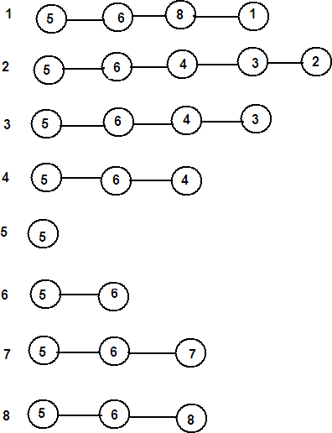
Single Source Shortest Paths

Slide 70
Bellman Ford Algorithm
The basic principle behind Bellman Ford algorithm is relaxation.
Input: Graph and a source vertex src
Output: Shortest distance to all vertices from src. If there is a negative weight cycle, then shortest distances are not calculated, negative weight cycle is reported.
1) This step initializes distances from the source to all vertices as infinite and distance to the source itself as 0. Create an array dist[] of size |V| with all values as infinite except dist[src] where src is source vertex.

Slide 71
2) This step calculates shortest distances. Do following |V|-1 times where |V| is the number of vertices in given graph.
a) Do following for each edge u-v
If dist[v] > dist[u] + weight of edge uv, then
update dist[v]
dist[v] = dist[u] + weight of edge uv
3) This step reports if there is a negative weight cycle in graph. Do following for each edge u-v
If dist[v] > dist[u] + weight of edge uv, then “Graph contains negative weight cycle”

Slide 72
The idea of step 3 is, step 2 guarantees the shortest distances if the graph doesn’t contain a negative weight cycle.
If we iterate through all edges one more time and get a shorter path for any vertex, then there is a negative weight cycle

Slide 73
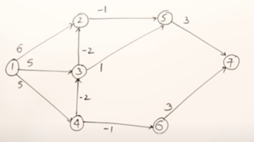
1-2
1-4
1-3
2-5
3-2
3-5
4-3
4-6
5-7
6-7
1-0
2-1
3-3
4-5
5-0
6-4
7-3

Slide 74
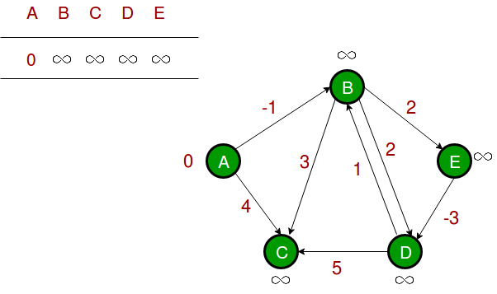
Let the given source vertex be 0. Initialize all distances as infinite, except the distance to the source itself. Total number of vertices in the graph is 5, so all edges must be processed 4 times.

Slide 75
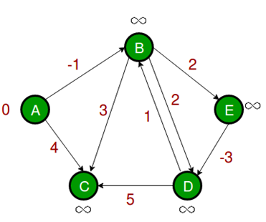
(A, B), (A, C), (B, D), (B, C), (B, E), (D, B), (D, C), (E, D).
If dist[v] > dist[u] + weight of edge uv, then update dist[v]
dist[v] = dist[u] + weight of edge uv

Slide 76
Let all edges are processed in the following order: (B, E), (D, B), (B, D), (A, B), (A, C), (D, C), (B, C), (E, D).
We get the following distances when all edges are processed the first time. The first row shows initial distances.
The second row shows distances when edges (B, E), (D, B), (B, D) and (A, B) are processed.
The third row shows distances when (A, C) is processed. The fourth row shows when (D, C), (B, C) and (E, D) are processed.

Slide 77
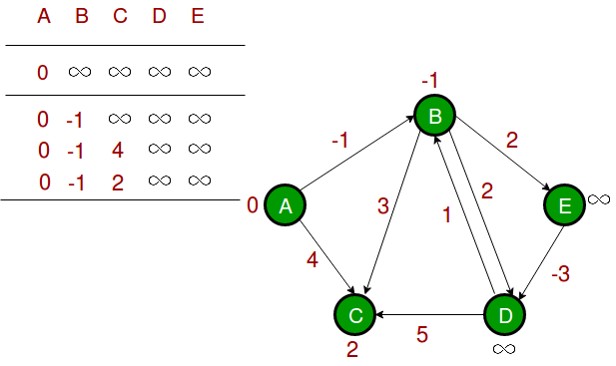

Slide 78
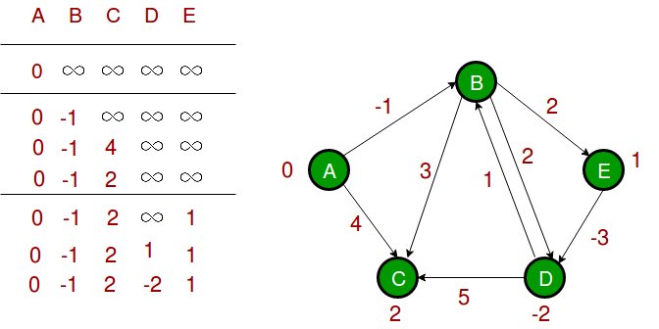
The first iteration guarantees to give all shortest paths which are at most 1 edge long. We get the following distances when all edges are processed second time (The last row shows final values).

Slide 79
The second iteration guarantees to give all shortest paths which are at most 2 edges long.
The algorithm processes all edges 2 more times.
The distances are minimized after the second iteration, so third and fourth iterations don’t update the distances.

Slide 80
Negative weights are found in various applications of graphs. For example, instead of paying cost for a path, we may get some advantage if we follow the path.
Bellman-Ford works better (better than Dijkstra’s) for distributed systems. Unlike Dijkstra’s where we need to find the minimum value of all vertices, in Bellman-Ford, edges are considered one by one.

Slide 82
Problem
Construct the Directed Graph for the given adjacency matrix. Consider 0 as the source vertex and find the shortest path using Dijkstra’s Algorithm.
 | 0 | 1 | 2 | 3 | 4 | 5 | 6 | 7
0 | 0 | 7 | 8 | 0 | 2 | 0 | 6 | 0
1 | 0 | 0 | 4 | 0 | 0 | 8 | 0 | 3
2 | 8 | 0 | 0 | 0 | 0 | 0 | 5 | 0
3 | 0 | 9 | 0 | 0 | 0 | 2 | 0 | 0
4 | 0 | 1 | 0 | 2 | 0 | 0 | 9 | 7
5 | 9 | 0 | 0 | 3 | 0 | 0 | 2 | 2
6 | 0 | 0 | 8 | 0 | 4 | 4 | 0 | 3
7 | 6 | 0 | 4 | 0 | 0 | 0 | 9 | 0

Slide 83
Floyd Warshall Algorithm
It is a dynamic programming formulation.
To solve the all-pairs shortest path problem on directed graphs.
It finds the shortest length from every vertex to every other vertex.
Considers the intermediate vertices of a simple path or any vertex present in that path other than the first and last vertex of that path.

Slide 84
To find the shortest path between every pair of nodes in the graph.
The condition used to solve the problem is
A[i, j] = min(A[i, j], A[i, k] + A[k, j])
Floyd-Warshall Algorithm was proposed by Robert Floyd in the year 1962. The same algorithm was proposed by Stephen Warshall during the same year for finding the transitive closure of the graph.

Slide 85
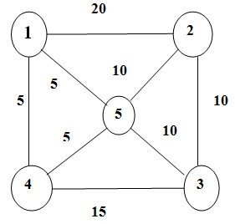
Example- Directed graph and its cost matrix
1 2 3 4 5
1
2
3
4
5
0 | 20 | ∞ | 5 | 5
20 | 0 | 10 | ∞ | 10
∞ | 10 | 0 | 15 | 10
5 | ∞ | 15 | 0 | 5
5 | 10 | 10 | 5 | 0

Slide 86
Pseudocode
ALLPAIRSHORTESTPATH(cost, A, n)
for i = 1 to n
for j = 1 to n
A[i, j] = cost[i, j]
end for
end for
for k = 1 to n
for i = 1 to n
for j = 1 to n
A[i, j] = min(A[i, j], A[i, k] + A[k, j])
end for
end for
end for

Slide 87
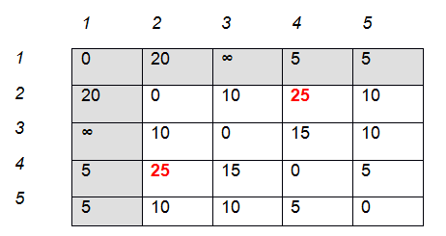
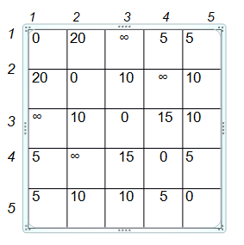
Iteration 1
K=1
i=1
J will vary from 1 to 5
A[i, j] = min(A[i, j], A[i, k] + A[k, j])

Slide 88
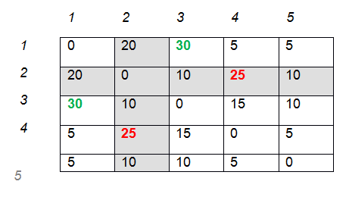
Iteration 2

Slide 89
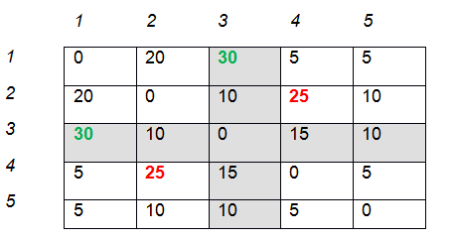
Iteration 3

Slide 90
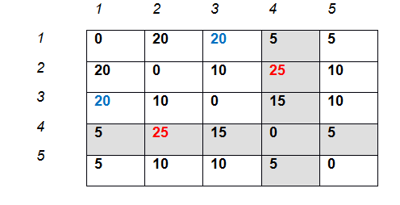
Iteration 4

Slide 91
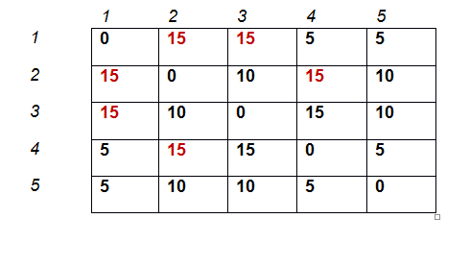
Final Output Matrix

Slide 92
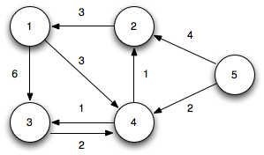
Example

Slide 93

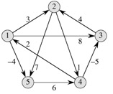

Example

Slide 94


Iteration 1

Slide 95


Iteration 2

Slide 96


Iteration 3

Slide 97


Iteration 4

Slide 98

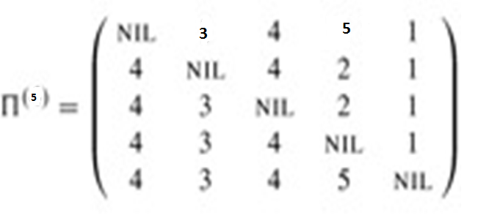
Iteration 5

Slide 99
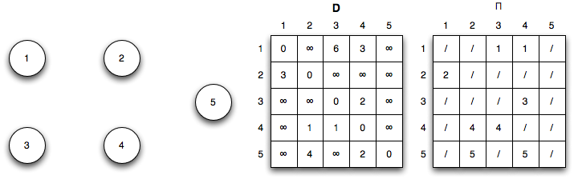
Initialization (k=0)

Slide 100
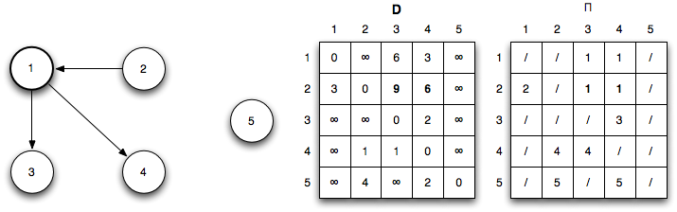
Iteration 1: k = 1
Shorter paths from 2 ↝ 3 and 2 ↝ 4 are found through vertex 1

Slide 101

Iteration 2: k = 2
Shorter paths from 4 ↝ 1, 5 ↝ 1, and 5 ↝ 3 are found through vertex 2

Slide 102

Iteration 2: k = 3
No shorter paths are found through vertex 3

Slide 103

Iteration 2: k = 4
Shorter paths from the vertex 4 are:
1 ↝ 2, 1 ↝ 3, 2 ↝ 3, 3 ↝ 1, 3 ↝ 2, 5 ↝ 1, 5 ↝ 2, 5 ↝ 3, and 5 ↝ 4

Slide 104

Iteration 2: k = 5
No shorter paths are found through vertex 5

Slide 105

Shortest Path

Slide 106
Analysis
The complexity of the algorithm is Ɵ(n³)

Slide 107
Real time Applications
To implement a service that manages a set of physical backup devices. When the system starts, all the shortest routes from every cabinet to every other cabinet are calculated, including special requests such as going through a particular computer. This information is stored in a large hashtable indexed by route descriptions and with routes as values.

Slide 108
Real time Applications
Fast computation of Pathfinder networks.
Maximum Bandwidth Paths in Flow Networks.
Transitive closure of directed graphs.
Optimal routing. In this application, the path with the maximum flow can be found between two vertices. This means that, rather than taking minima as in the pseudocode above, one instead takes maxima.

